Slide 1

SPARK

Slide 2
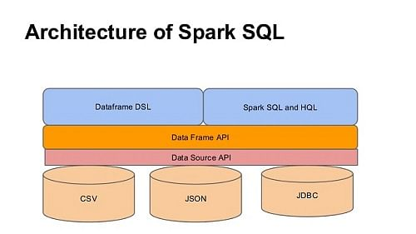
CONTENTS
Introduction to Spark SQL
Introduction to DataSets

Slide 3
Introduction to Spark SQL
Apache Spark SQL integrates relational processing with Sparks functional programming.
It is Spark module for structured data processing. Spark SQL blurs the line between RDD and relational table.
It also offers much tighter integration between relational and procedural processing, through declarative DataFrame APIs which integrates with Spark code.
It thus provides higher optimization. DataFrame API and Datasets API are the ways to interact with Spark SQL. As a result, with Spark SQL, Apache Spark is accessible to more users and improves optimization for current ones.

Slide 4
Spark SQL runs on top of the Spark Core.
It allows developers to import relational data from Hive tables and parquet files, run SQL queries over imported data and existing RDDs and easily write RDDs out to Hive tables or Parquet files.
As Spark SQL provides DataFrame APIs which performs the relational operation on both external data sources and Sparks built-in distributed collections.
Spark SQL introduces extensible optimizer called Catalyst as it helps in supporting a wide range of data sources and algorithms in Bigdata.

Slide 5
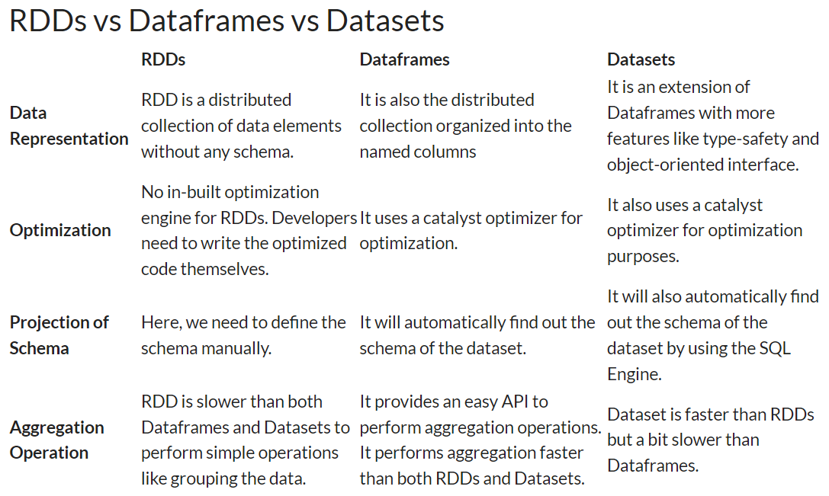

Slide 6
Apache Spark SQL Interface
i. DataFrame
Spark DataFrames evaluates lazily like RDD Transformations in Apache Spark.
A DataFrame is equivalent to the relational table in Spark SQL. A DataFrame stores the data into tables. DataFrame is similar/identical to a table in a relational database but with richer optimization.
It is a data abstraction and domain-specific language (DSL) applicable on the structure and semi-structured data.
It is a distributed collection of data in the form of named column and row. For accessing data frames either SQL Context or Hive Context is needed.

Slide 7
ii. SQLContext
It’s the entry point for working with structured data (rows and columns) in Apache Spark.
It Allows the creation of DataFrame objects as well as the execution of SQL queries.
iii. Hive Context
Working with Hive tables, a descendant of SQLContext.
Hive Context is more battle-tested and provides a richer functionality than SQLContext.

Slide 8
iv. DataSets
A Spark DataSet provides the benefits of RDDs.
For example, strongly-typed, immutable collection of objects that map to the relational schema already present (i.e. you can use a field of a row by name naturally row.columnName).
Datasets extend the benefit of compile-time type safety (It can analyze the applications for errors before they run).
It also allows direct operations over user-defined classes.

Slide 9
v. JDBC Datasource
In Apache Spark, JDBC data source can read data from relational databases using JDBC API.
It has preference over the RDD because the data source returns the results as a DataFrame, can be handled in Spark SQL or joined beside other data sources.
vi. Catalyst Optimizer
It is a functional programming construct in Scala.
It is the newest and most technical component of Spark SQL.

Slide 10
A catalyst is a query plan optimizer.
It provides a general framework for transforming trees, which performs analysis/evaluation, optimization, planning, and runtime code spawning.
Catalyst supports cost based optimization and rule-based optimization. It makes queries run much faster than their RDD counterparts.
A catalyst is a rule-based modular library. Each rule in framework focuses on the distinct optimization.

Slide 11
Features of Apache Spark SQL
There are several features of Spark SQL which enhance which makes it a key component of Apache Spark framework.
i. Integrated
Logically mix SQL queries with Spark programs.
Apache Spark SQL allows query structured data inside Spark programs, using SQL or a DataFrame API in Java, Scala, Python, and R.

Slide 12
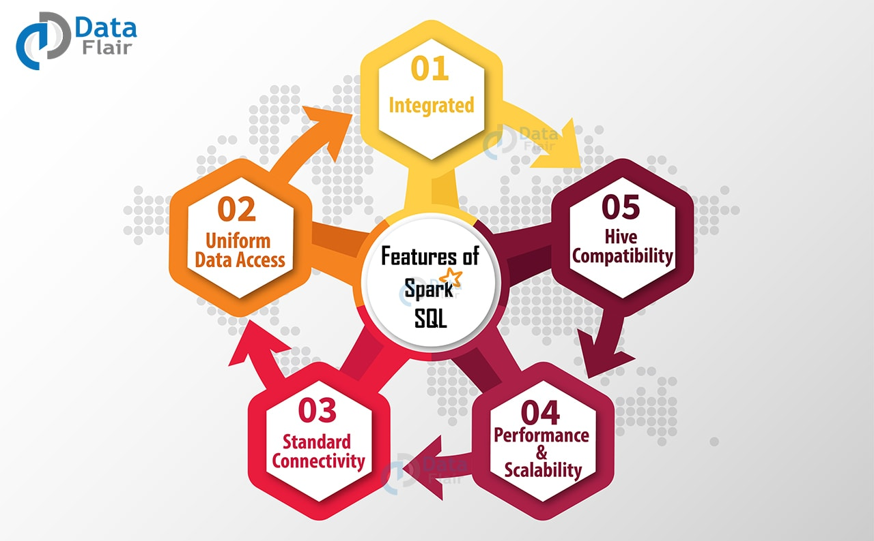

Slide 13
ii. Uniform Data Access
In Spark DataFrames and SQL supports a common way to access a variety of data sources, like Hive, Avro, Parquet, ORC, JSON, and JDBC.
Hence Spark SQL can join data across these sources.
iii. Hive Compatibility
Runs unmodified Hive queries on current data.
Spark SQL rewrites the Hive frontend and meta store, allowing full compatibility with current Hive data, queries, and UDFs.

Slide 14
iv. Standard Connectivity
Connect through JDBC or ODBC.
A server that supports industry norms JDBC and ODBC connectivity for business intelligence tools.
v. Performance & Scalability
Apache Spark SQL incorporates a cost-based optimizer, code generation, and columnar storage to make queries agile alongside computing thousands of nodes using the Spark engine, which provides full mid-query fault tolerance.

Slide 15
Conclusion
Hence, Spark SQL allows Apache Spark to work with structured and unstructured data.
The data can be from various sources.
It enhances the performance of Spark applications.
As a result, It provides an efficient platform to the Spark developers to work with various type of data.

Slide 16
Introduction to Spark DataSet
Dataset is a data structure in SparkSQL which is strongly typed and is a map to a relational schema.
It represents structured queries with encoders.
It is an extension to data frame API.
Spark Dataset provides both type safety and object-oriented programming interface.

Slide 17
The encoder is primary concept in serialization and deserialization (SerDes) framework in Spark SQL.
Encoders translate between JVM objects and Spark’s internal binary format.
Spark has built-in encoders which are very advanced. They generate bytecode to interact with off-heap data.
An encoder provides on-demand access to individual attributes without having to de-serialize an entire object.
To make input-output time and space efficient, Spark SQL uses the SerDe framework. Since encoder knows the schema of record, it can achieve serialization and deserialization.

Slide 18
Spark Dataset is structured and lazy query expression that triggers the action.
Internally dataset represents a logical plan.
The logical plan tells the computational query that we need to produce the data. the logical plan is a base catalyst query plan for the logical operator to form a logical query plan.
When we analyze this and resolve we can form a physical query plan.

Slide 19
Dataset clubs the features of RDD and DataFrame.
It provides:
The convenience of RDD.
Performance optimization of DataFrame.
Static type-safety of Scala.
Thus, Datasets provides a more functional programming interface to work with structured data.

Slide 20
Need of Dataset in Spark
To overcome the limitations of RDD and Dataframe, Dataset emerged.
In DataFrame, there was no provision for compile-time type safety.
Data cannot be altered without knowing its structure.
In RDD there was no automatic optimization.
So for optimization, we do it manually when needed.

Slide 21
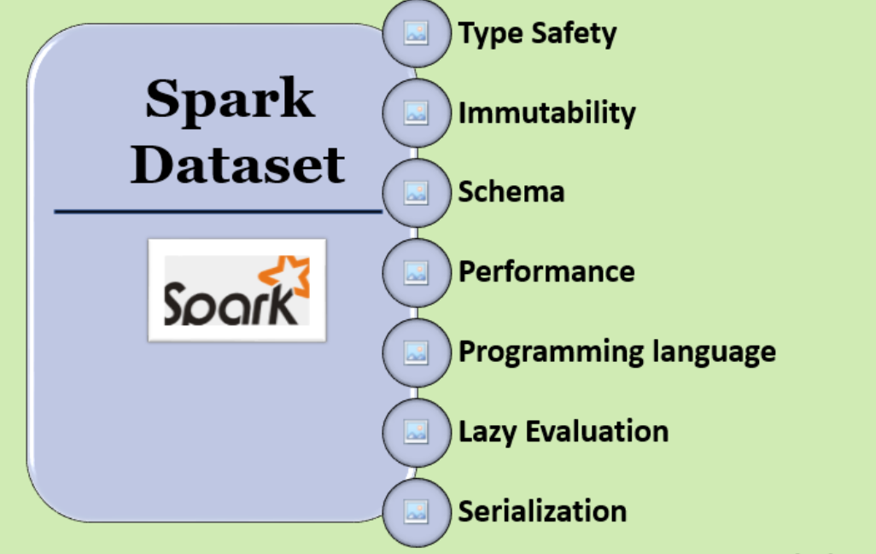

Slide 22
Features of Dataset in Spark
a. Optimized Query
Dataset in Spark provides Optimized query using Catalyst Query Optimizer and Tungsten.
Catalyst Query Optimizer is an execution-agnostic framework.
It represents and manipulates a data-flow graph.

Slide 23
Data flow graph is a tree of expressions and relational operators.
By optimizing the Spark job Tungsten improves the execution.
Tungsten emphasizes the hardware architecture of the platform on which Apache Spark runs.
b. Analysis at compile time
Using Dataset we can check syntax and analysis at compile time.
It is not possible using Dataframe, RDDs or regular SQL queries.

Slide 24
c. Persistent Storage
Spark Datasets are both serializable and Queryable. Thus, we can save it to persistent storage.
d. Inter-convertible
We can convert the Type-safe dataset to an “untyped” DataFrame.
To do this task Datasetholder provide three methods for conversion from Seq[T] or RDD[T] types to Dataset[T]:
toDS(): Dataset[T]
toDF(): DataFrame
toDF(colNames: String*): DataFrame

Slide 25
e. Faster Computation
The implementation of the Dataset is much faster than the RDD implementation.
Thus increases the performance of the system.
For the same performance using the RDD, the user manually considers how to express computation that parallelizes optimally.
f. Less Memory Consumption
While caching, it creates a more optimal layout.
Spark knows the structure of data in the dataset.

Slide 26
g. Single API for Java and Scala
It provides a single interface for Java and Scala.
This unification ensures we can use Scala interface, code examples from both languages. It also reduces the burden of libraries.
As libraries have no longer to deal with two different type of inputs.

Slide 27
Creating Dataset
To create a Dataset we need:
a. SparkSession
SparkSession is the entry point to the SparkSQL.
It is a very first object that we create while developing Spark SQL applications using fully typed Dataset data abstractions. Using SparkSession.
Builder, we can create an instance of SparkSession. And can stop SparkSession using the stop method (spark.stop).

Slide 28
b. QueryExecution
We represent structured query execution pipeline of the dataset using QueryExecution.
To access QueryExecution of a Dataset use QueryExecution attribute.
By executing a logical plan in Spark Session we get QueryExecution.
executePlan(plan: LogicalPlan): QueryExecution
executePlan executes the input LogicalPlan to produce a QueryExecution in the current SparkSession.

Slide 29
c. Encoder
An encoder provides conversion between tabular representation and JVM objects.
With the help of the encoder, we serialize the object.
Encoder serializes objects for processing or transmitting over the network encoders.

Slide 30
Conclusion
Hence, in conclusion to Dataset, we can say it is a strongly typed data structure in Apache Spark.
Moreover, it represents structured queries.
Also, it fuses together the functionality of RDD and DataFrame.
We can generate the optimized query using Dataset.
So, Dataset lessens the memory consumption and provides a single API for both Java and Scala.

Slide 31
END OF SESSION
Q&A

